Slide 1
Capstone Design Final Demo Presentation

Slide 2
Meet the Team
1
AN JISU
LEE HYUNJAE
JEON JINWOO
Jane Doe
Jane Doe
Jane Doe
BACKEND DEVELOPER
backend developer
FRONTEND DEVELOPER
Server management, Server-side development
Database, Server-side development
Highlight algorithm, Dashboard UI
ajs7270@gmail.com
leehj8687@email.com
zinuzian@gmail.com
Notes:
© Copyright Showeet.com – Creative & Free PowerPoint Templates

Slide 3
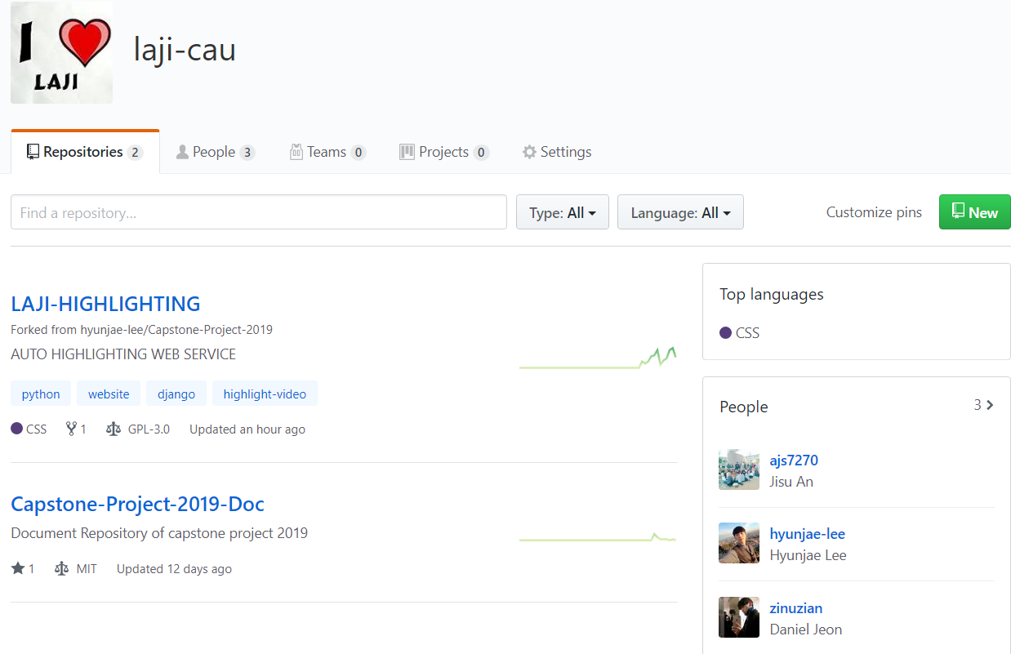
LAJI - https://github.com/laji-cau

Slide 4
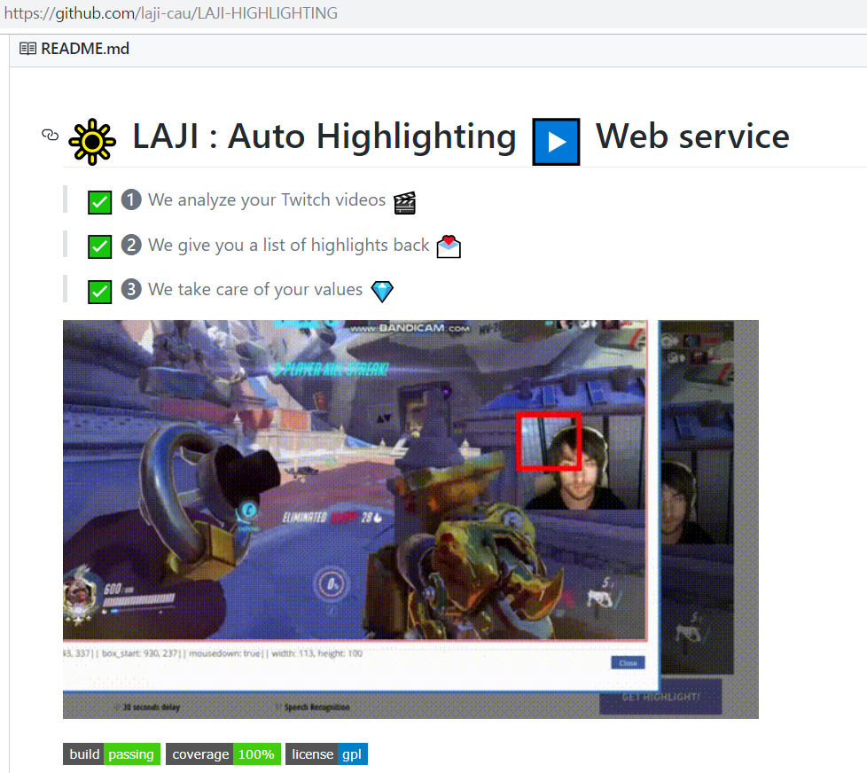
LAJI

Slide 5
Contents
Demo scenario
Demo
Q&A

Slide 6

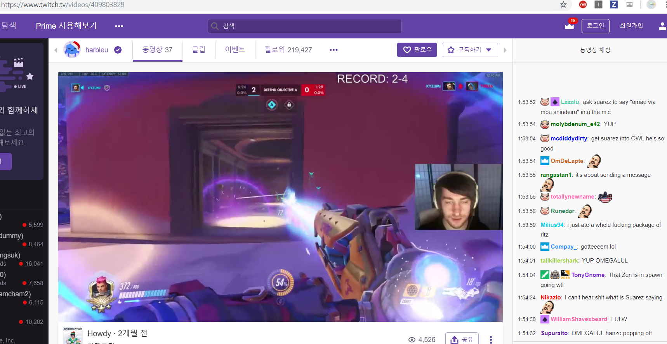
Demo materials
https://www.twitch.tv/videos/409803829
This video is
6 hours long,
16GB

Slide 7
Demo scenario
Login (ajs7270)
Upload (Face recognition)
Login as another one (leehj8687)
Payment
Leave account
Login again(leehj8687)
Email check
History check

Slide 8
Final Demo

Slide 9
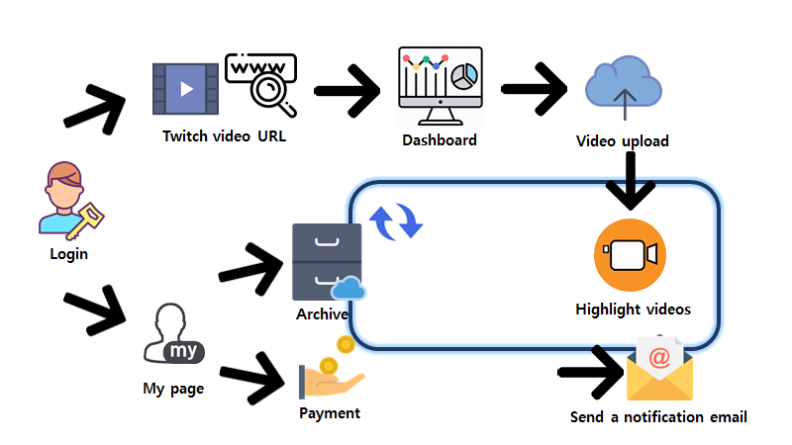

Slide 10
Demo scenario
Login (ajs7270)
Upload (Face recognition)
Login as another one (leehj8687)
Payment
Leave account
Login again(leehj8687)
Email check
History check

Slide 11
Development plans
Week | Plan
2nd | Idea & Proposal
3rd | Idea & Proposal
4th | Server construction (Configuration setup : Nginx, domain(bind9), https), Test videos (Twitch/Game/Eng)
5th | Login (SNS), Database
6th | Video upload & download, Twitch chat API analyze
7th | Frame resizing, Web UI, Designing highlight algorithm
8th | Demo

Slide 12
Development plans
9th | Highlight video analyze algorithm development and test
10th | Highlight video analyze algorithm development and test
11st | Highlight video analyze algorithm development and test
12nd | Toss (payment), Notification mail, algorithm development, Server test
13rd | Preparing for Final demo , Queueing for threads
14th | Final demo
15th | Final report

Slide 13
Development plans
Jisu An,
Hyunjae Lee,
Jinwoo Jeon,

Slide 14
Thank you!

